Slide 1
Assignment 4 – Support Vector Machine & Naive bayes Introduction to Data Analysis (DATA 1200) Prof. Ritwick Dutta
Dheer Parikh
100919437

Slide 2
Introduction
In this assignment we have to predict the type of rice i.e. `Kesimen` or `Besni` by leveraging the dataset ‘raisin_dataset.csv’ by applying two algorithms namely Support Vector Machine & Naïve Bayes, and compare the difference of their outcomes.

Slide 3
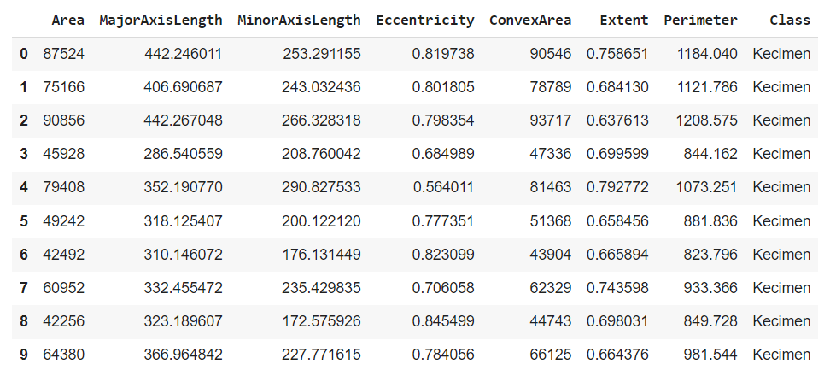
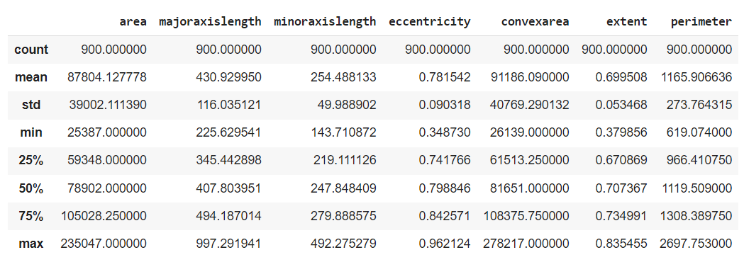
Understanding dataset:
Fig. 1 – first 10 rows of dataset
Fig. 2 – statistical description of dataset
From the given dataset it can be seen that the information is in pixel it means that this resembles to pictures which were converted to pixel form. The primary focus of this project is to identify the Class of rice on the bases of Area: No. of pixels within the boundary of Raisin , Major Axis Length: Longest line that can be drawn on raisin, Minor Axis Length: shortest line that can be drawn on raisin, Convex Area:, Extent: Ratio of raisin covered under pixels by total pixels, Perimeter: Distance between boundaries and pixel around raisin, eccentricity: eccentricity of eclipse which has same moment as raisin along with our target variable which is Class, which contains two values namely Kecimen and Besni.
From the descriptive stats, there are 900 observation with no null values in it. As it seems that this are the data in picture format which are converted to pixel format, the maximum area covered by any raisin is 235047 pixels, major axis length is 997.29, minor axis length is 492.27. Notable thing from the dataset is the standard deviation is comparatively high for most of the variable expect eccentricity, which suggests that there might be some outliers and dataset might not follow normal distribution curve.

Slide 4
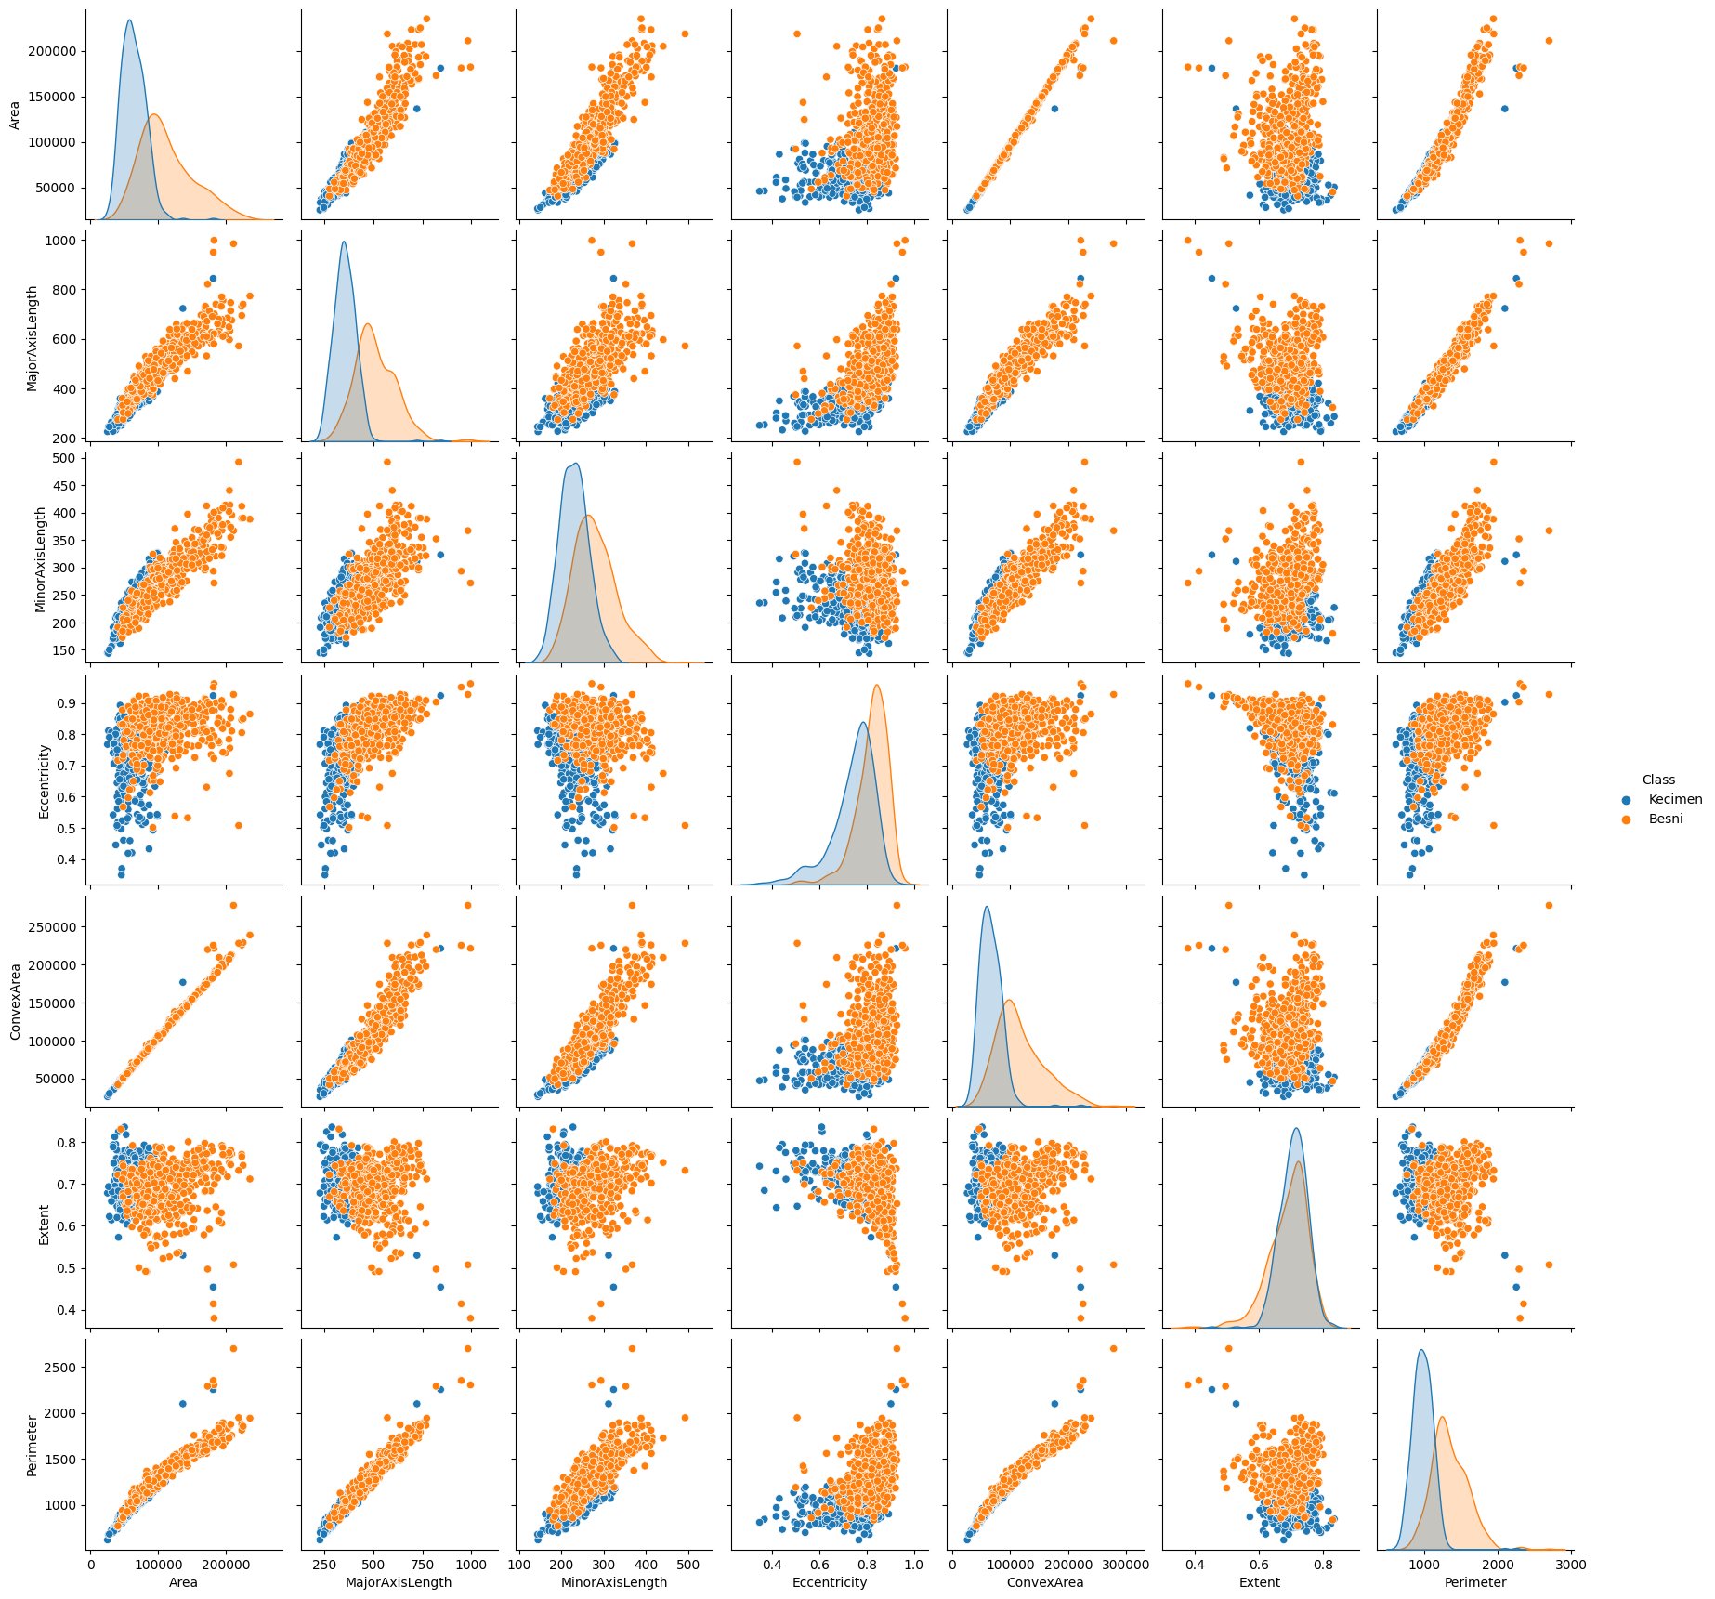
Understanding Pair plot:
In Pair plot the diagonal represents distribution of data, the distribution of data gives us an insight that mean ‘Kecimen’ have larger area, major axis length, minor axis length, convex area and Perimeter than ‘Besni’ , whereas, In terms of Extend, ‘Kecimen’ is slightly higher than ‘Besni’, and eccentricity of ‘Besni’ is slightly higher than ‘Kecimen’.
Area exhibits strong positive relationship with Convex Area and Perimeter with minimum outliers, whereas, it has comparitvely less strong positive relationship with MajorAxisLength and MinorAxisLength, it is notable that for eccentricity and Extent both class can be sperable.
Fig. 3 – Pair plot

Slide 5
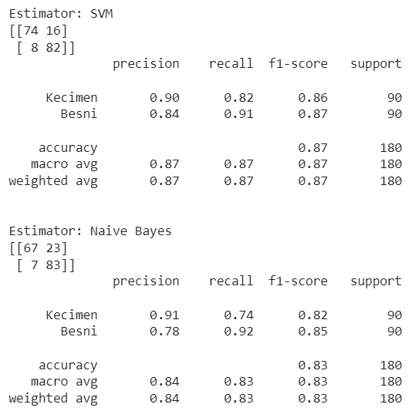
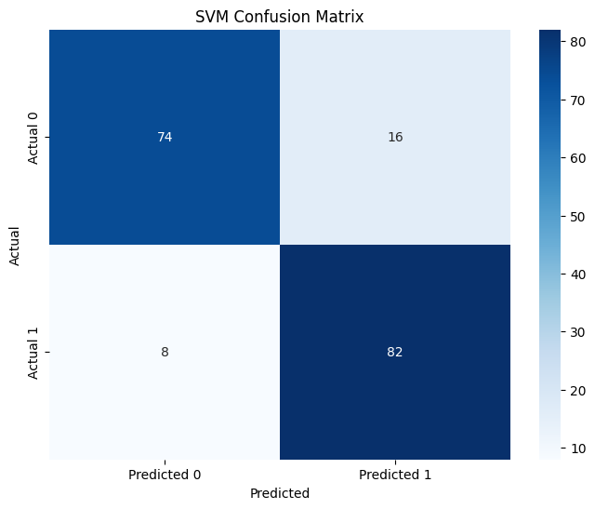
Interpretation of SVM Classification:
Fig. 4 – Performance Matrices
Fig. 5 – Confusion Matrices
The SVM model achieved an overall accuracy of nearly 87% and it predicted 74 & 82 correct Kecimen and Besni.
It is notable that the model is slightly more precise identifying Kecimen compared to Besni
The true positive rate ‘recall` of Besni is higher than Kecimen, whereas, f1-score is nearly equal for both classes.

Slide 6
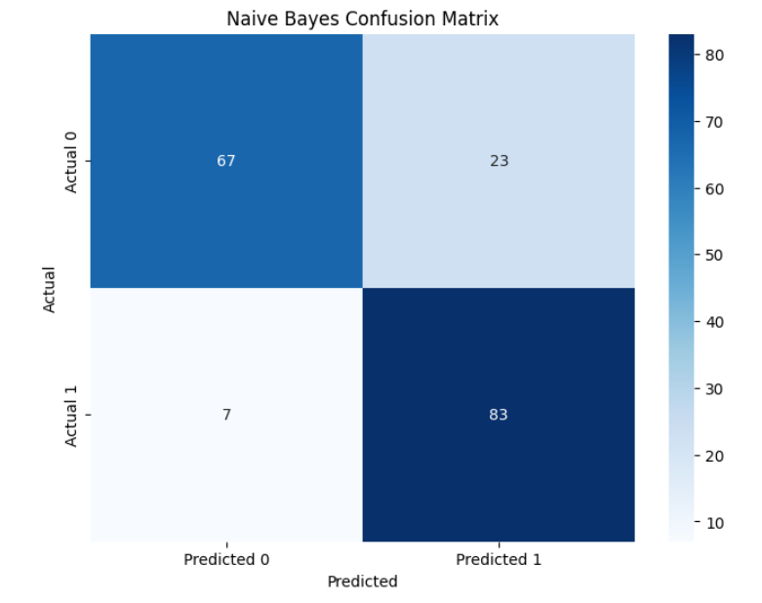
Interpretation of NB Classification:
Fig. 6 – Performance Matrices
Fig. 7 – Confusion Matrices
The NB model achieved an overall accuracy of nearly 83% and it predicted 67 & 83 correct Kecimen and Besni.
It is notable that the model is more precise identifying Kecimen compared to Besni.
The true positive rate ‘recall` of Besni is comparatively higher than Kecimen, whereas, f1-score for Besni is slightly more higher.

Slide 7
Major difference between two models:
Precision and Recall Balance
The SVM model has a more balanced precision and recall for both the classes, while the Naïve Bayes model has a higher recall for 'Kecimen' but lower precision for 'Besni'. This suggests that SVM might be more consistent in performance across different classes. Higher recall and lower precision means NB algorithm is covering wider range of class with false positivity.
F1-Score
The F1-score, which is the mean of precision and recall, is slightly higher for the 'Kecimen' class in the SVM model than in the Naïve Bayes model. This indicates that the SVM model may provide a better balance between precision and recall for Kecimen.

Slide 8
Recommendations & ways to improve model:
It is recommended to Mr. John to imply Support Vector Machine Classification algorithm instead of Naïve Bayes.
Data cleaning and Data standardization must be done. From the descriptive statistics it is clear that there can be many outliers and SVM which performed better with respected to NB is prone to outliers. Hyperparameters must be tuned properly.
As the dataset seems to be originally in picture format converted to pixel format, deep learning techniques might be an option to be considered.

